Slide 1


Diego Asturiano Calva
16-05-2025

Slide 2

Outline
Executive Summary
Introduction
Methodology
Results
Conclusion
Appendix

Slide 3
Executive Summary
Summary of methodologies
Collection API
Web scraping
Data wrangling
EDA Using SQL
EDA Using Pandas and Matplotlib
Interactive Visual Analytics with Folium lab
Summary of all results
Interactive Dashboard with Ploty Dash
Machine Learning Prediction

Slide 4
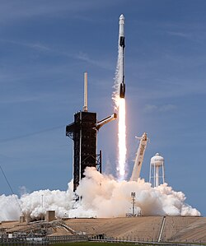
Introduction
Project background and context
SpaceX advertises Falcon 9 rocket launches on its website, with a cost of 62 million dollars; other providers cost upward of 165 million dollars each, much of the savings is because SpaceX can reuse the first stage. Therefore, if we can determine if the first stage will land, we can determine the cost of a launch. This information can be used if an alternate company wants to bid against SpaceX for a rocket launch.
Problems you want to find answers
We will predict if the Falcon 9 first stage will land successfully. SpaceX advertises Falcon 9 rocket launches on its website

Slide 5

Section 1

Slide 6
Methodology
Executive Summary
Data collection methodology:
Data Collection API
Data Collection with Web Scraping
Perform data wrangling
Perform exploratory data analysis (EDA) using visualization and SQL
Perform interactive visual analytics using Folium and Plotly Dash
Perform predictive analysis using classification models

Slide 7
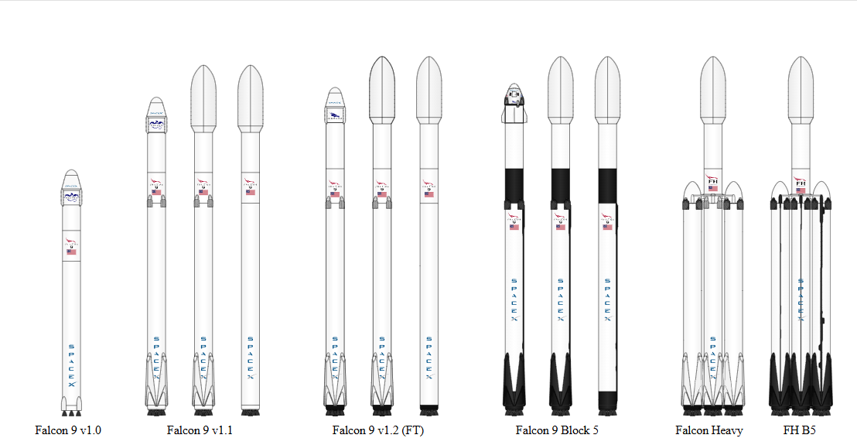
Data Collection
Falcon 9 space X data was collected by different methods and from different sources.
Get request to the SpaceX API. Request and parse the SpaceX launch data using the GET request. JSON.
Web scraping to compile historical Falcon 9 launch records from a Wikipedia page titled List of Falcon 9 and Falcon Heavy launches. Extract all column/variable names from the HTML table header. BeautifulSoup.

Slide 8
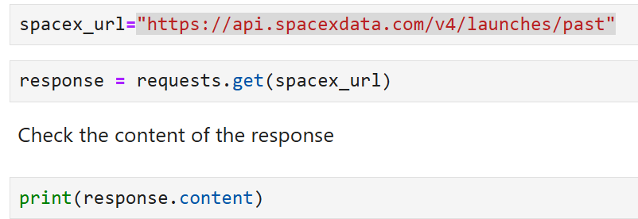
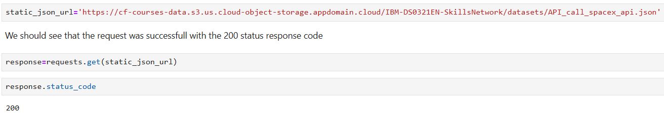
Data Collection – SpaceX API
Let's start requesting rocket launch data from SpaceX API with the following URL:
https://api.spacexdata.com/v4/launches/past
To make the requested JSON results more consistent, I useed the following static response object for this project.
GitHub SpaceX API calls notebook:https:
https://github.com/Diego-Asturiano/Data_Science_Capstone_Falcon9_SpaceX_Launch/blob/97debc8c469fb2301999bc7af02e6168c285020a/1.1%20Collection%20API.ipynb

Slide 9
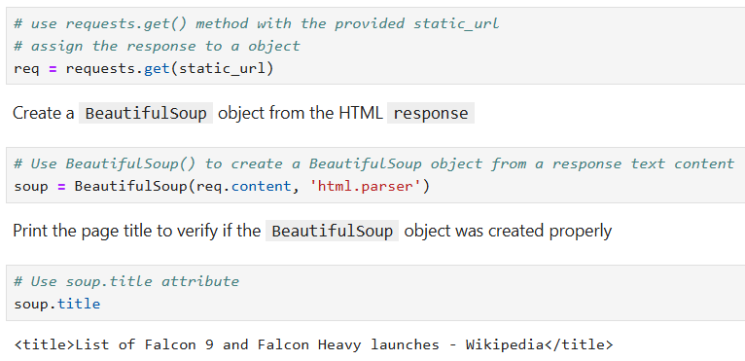
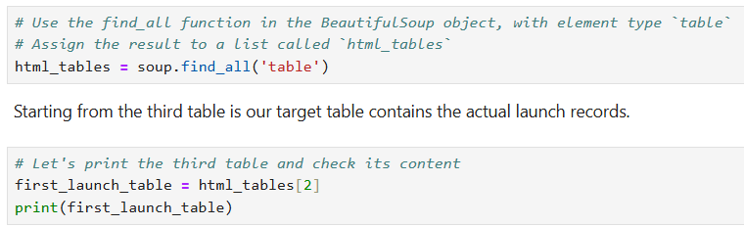
Data Collection - Scraping
Request the Falcon9 Launch Wiki page from its URL:
https://en.wikipedia.org/w/index.php?title=List_of_Falcon_9_and_Falcon_Heavy_launches&oldid=1027686922
Let's perform an HTTP GET method to request the Falcon9 Launch HTML page, as an HTTP response.
Extract all column names from the HTML table header. Then, create a data frame by parsing the launch HTML tables
GitHub URL of the completed web scraping notebook:
https://github.com/Diego-Asturiano/Data_Science_Capstone_Falcon9_SpaceX_Launch/blob/97debc8c469fb2301999bc7af02e6168c285020a/1.2%20Webscraping.ipynb

Slide 10
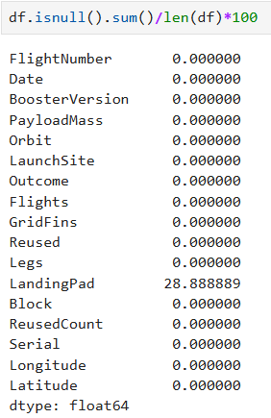
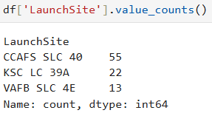
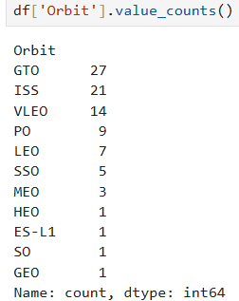
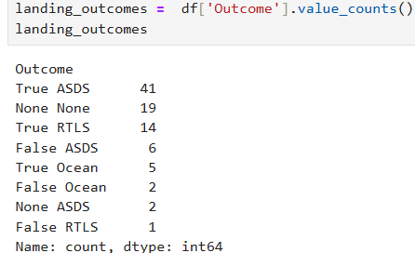
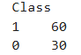
Data Wrangling
The Exploratory Data Analysis (EDA) was performed to find some patterns in the data and determine what would be the label for supervised model training.
The Space X data set from the previous section is loaded. The percentage of missing values for each attribute was identified and calculated.
The following calculations were made:
Calculate the number of launches on each site
Calculate the number and occurrence of each orbit
Calculate the number and occurrence of mission outcome of the orbits
Finally, a landing result tag was created from the Result column.
GitHub URL of data wrangling related notebooks:
https://github.com/Diego-Asturiano/Data_Science_Capstone_Falcon9_SpaceX_Launch/blob/97debc8c469fb2301999bc7af02e6168c285020a/1.3%20Data%20wrangling.ipynb

Slide 11
EDA with Data Visualization
In this section we created scatter and bar charts with Python to analyze data in a Pandas data frame. We performed exploratory data analysis by manipulating data in a Pandas data frame and executed SQL queries to select and sort data.
Visualize the relationship between Flight Number and Launch Site. Scatterplot
Visualize the relationship between Payload Mass and Launch Site - Scatterplot
Visualize the relationship between success rate of each orbit type - bar plot
Visualize the relationship between Flight Number and Orbit type – Scatterplot
Visualize the relationship between Payload Mass and Orbit type - Scatterplot
Visualize the launch success yearly trend – Line Plot
GitHub URL of EDA with data visualization notebook:
https://github.com/Diego-Asturiano/Data_Science_Capstone_Falcon9_SpaceX_Launch/blob/666c475415295fdc01b0778dfb7fff901c8e4c0f/2.2%20EDA%20Using%20Pandas%20and%20Matplotlib.ipynb

Slide 12
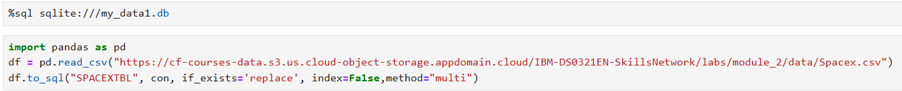
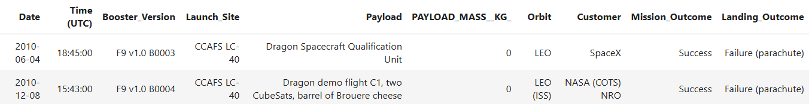
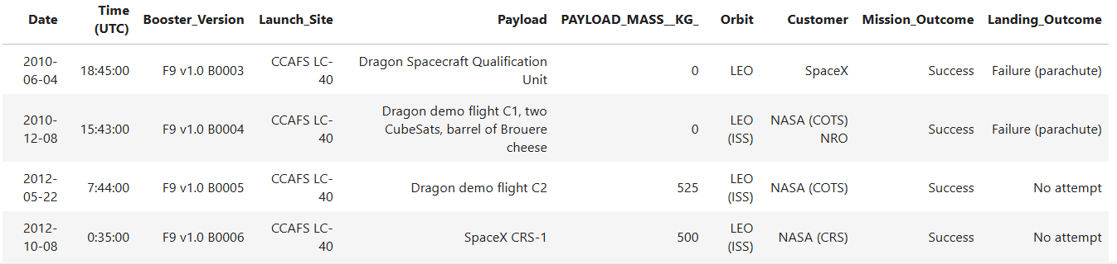
EDA with SQL
Load the dataset into the corresponding table in a Db2 database.
Display the names of the unique launch sites in the space mission.
Display 5 records where launch sites begin with the string 'CCA'

Slide 13
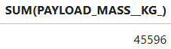
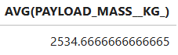
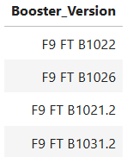
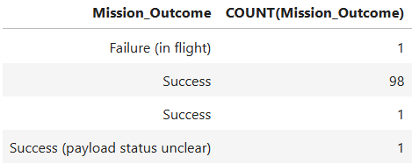
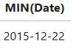
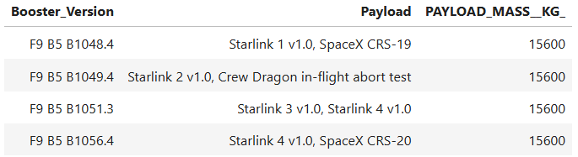
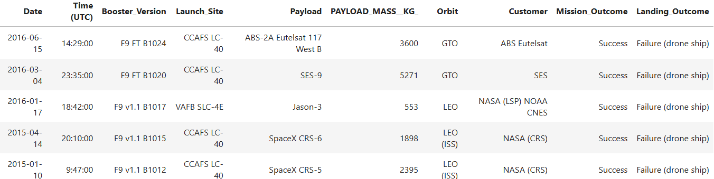
EDA with SQL
Display the total payload mass carried by boosters launched by NASA (CRS)
Display average payload mass carried by booster version F9 v1.1
List the date when the first successful landing outcome in ground pad was achieved.
List the names of the boosters which have success in drone ship and have payload mass greater than 4000 but less than 6000
List the total number of successful and failure mission outcomes.
List all the booster versions that have carried the maximum payload mass. Use a subquery.
Rank the count of landing outcomes (such as Failure (drone ship) or Success (ground pad)) between the date 2010-06-04 and 2017-03-20, in descending order.
3. 4.
5. 6. 7.
8.
9.
GitHub URL of EDA with SQL notebook:
URL

Slide 14
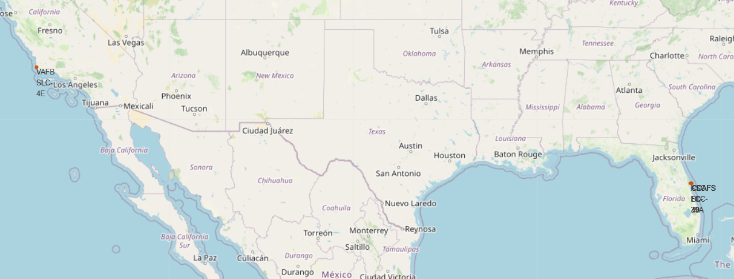
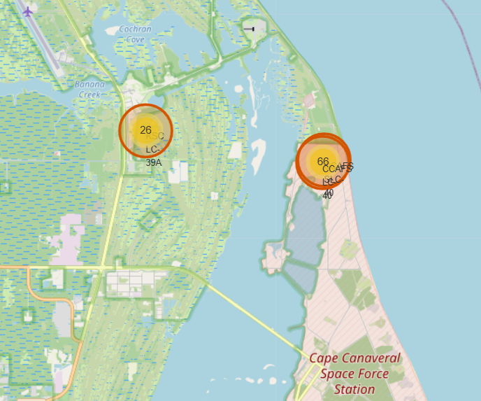
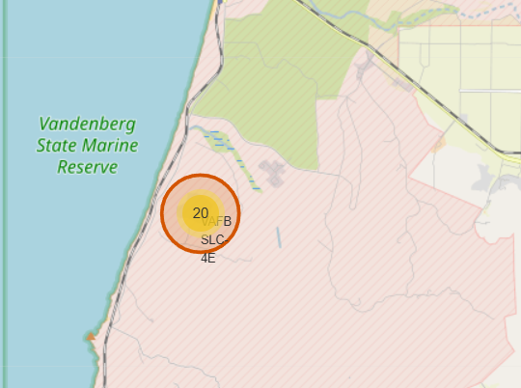
Build an Interactive Map with Folium
Finding an optimal location for building a launch site certainly involves many factors, we could discover some of the factors by analyzing the existing launch site locations.
In this section the following folium maps were created:
Mark all launch sites on a map.
Mark the success/failed launches for each site on the map.
GitHub URL of interactive map with Folium map:
https://github.com/Diego-Asturiano/Data_Science_Capstone_Falcon9_SpaceX_Launch/blob/666c475415295fdc01b0778dfb7fff901c8e4c0f/3.1%20Interactive%20Visual%20Analytics%20with%20Folium%20lab.ipynb

Slide 15
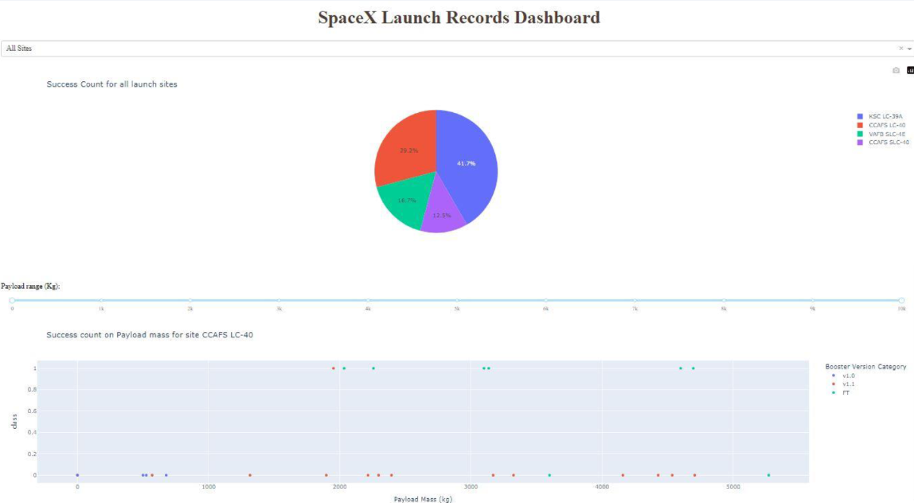
Build a Dashboard with Plotly Dash
An interactive dashboard containing pie charts and scatter plots was built to analyze launch records interactively with Plotly Dash.
GitHub URL of Plotly Dash lab:
https://github.com/Diego-Asturiano/Data_Science_Capstone_Falcon9_SpaceX_Launch/blob/666c475415295fdc01b0778dfb7fff901c8e4c0f/3.2%20Build%20an%20Interactive%20Dashboard%20with%20Ploty%20Dash.py
Ploty Dash App

Slide 16
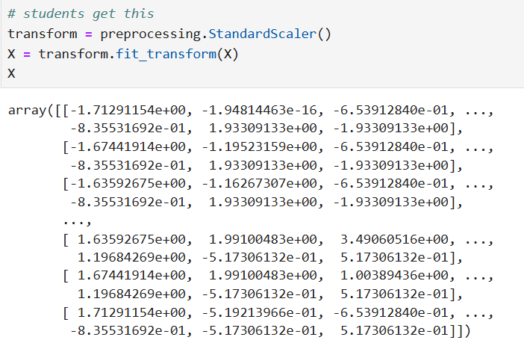
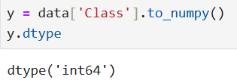
Predictive Analysis (Classification)
A predictive analysis of the data was performed, and training labels were determined.
Created a column for the class.
Standardize the data.
Split the data into training data and test data.
Find the best hyperparameter for SVM, classification trees and logistic regression.
Create a NumPy array from the column Class in data, by applying the method to_numpy().
Standardize the data in X then reassign it to the variable X.

Slide 17
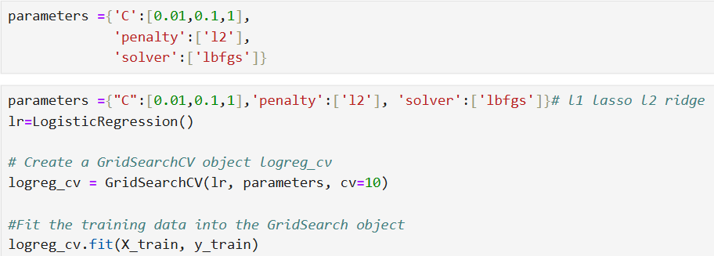
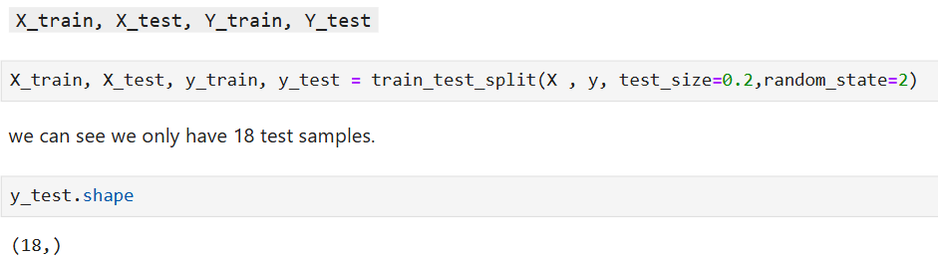
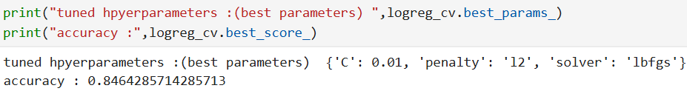
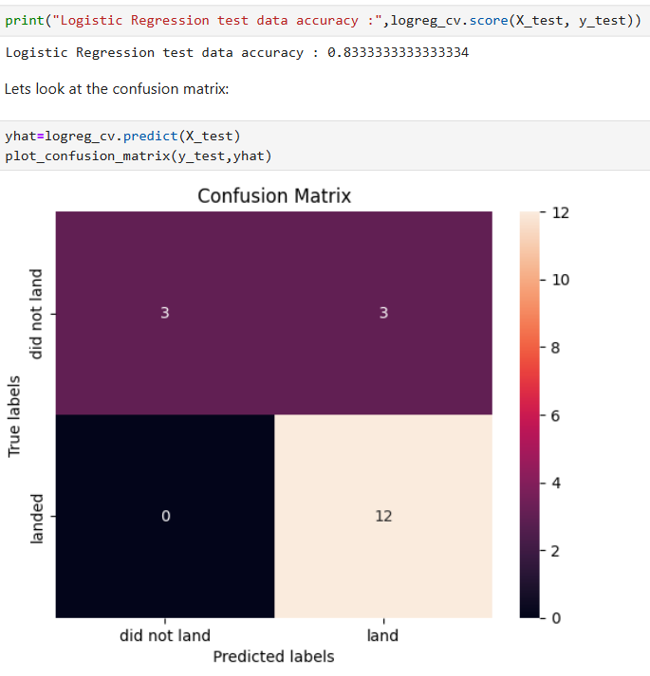
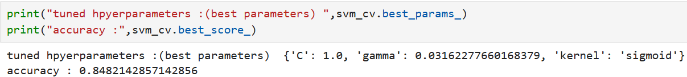
Predictive Analysis (Classification)
Use the function train_test_split to split the data X and Y into training and test data. Set the parameter test_size to 0.2 and random state to 2.
Calculate the accuracy on the test data using the method score.
Create a logistic regression object then create a GridSearchCV object logreg_cv with cv = 10.
Create a support vector machine object then create a GridSearchCV object svm_cv with cv = 10.

Slide 18
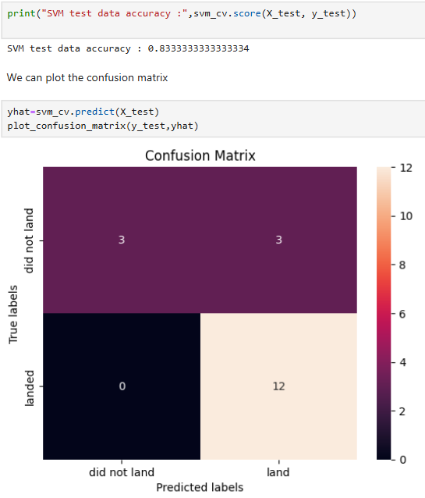
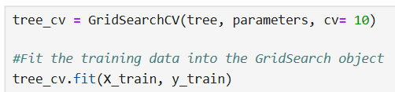
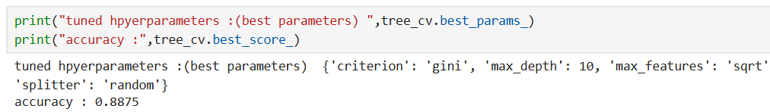
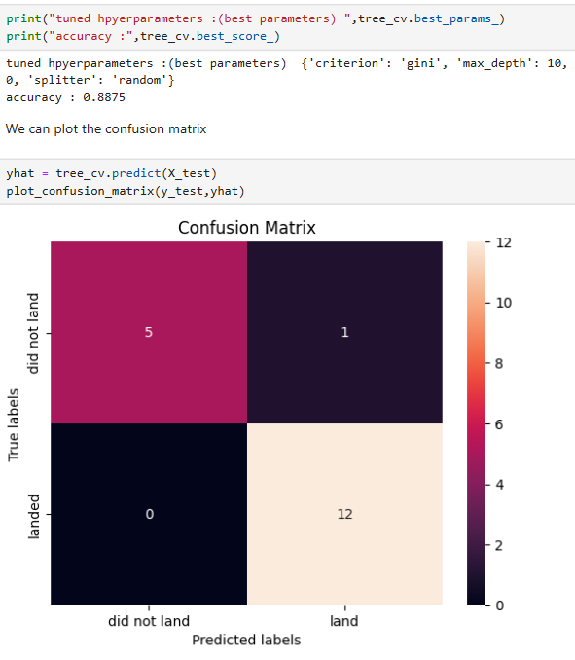
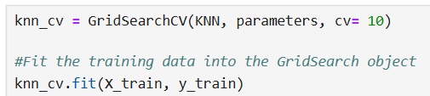
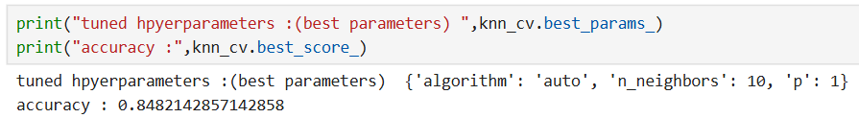
Create a decision tree classifier object then create a GridSearchCV object tree_cv with cv = 10.
Predictive Analysis (Classification)
Calculate the accuracy on the test data using the method score:
Create a k nearest neighbors object then create a GridSearchCV object knn_cv with cv = 10.
Create a logistic regression object then create a GridSearchCV object logreg_cv with cv = 10.
Calculate the accuracy of tree_cv on the test data using the method score:

Slide 19
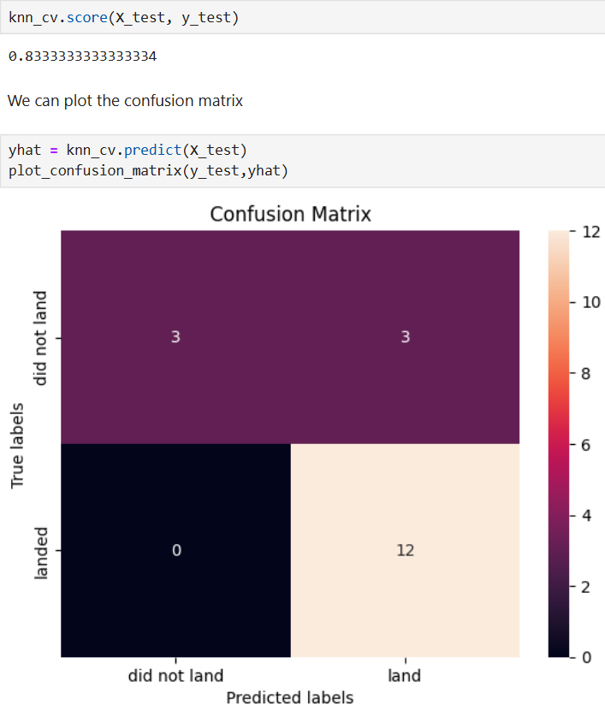
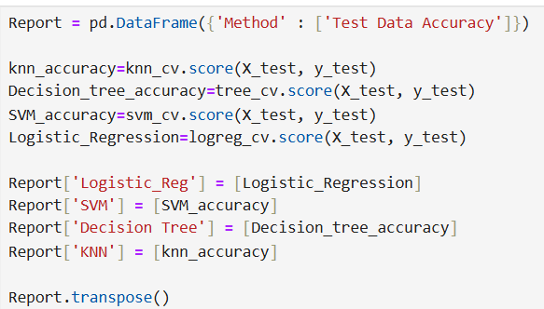
Create a decision tree classifier object then create a GridSearchCV object tree_cv with cv = 10.
Predictive Analysis (Classification)
Calculate the accuracy of knn_cv on the test data using the method score:
Find the method performs best:
GitHub URL predictive análisis:
https://github.com/Diego-Asturiano/Data_Science_Capstone_Falcon9_SpaceX_Launch/blob/666c475415295fdc01b0778dfb7fff901c8e4c0f/4.%20Machine%20Learning%20Prediction.ipynb

Slide 20
Results
Exploratory data analysis results
Interactive analytics demo in screenshots
Predictive analysis results

Slide 21

Section 2

Slide 22
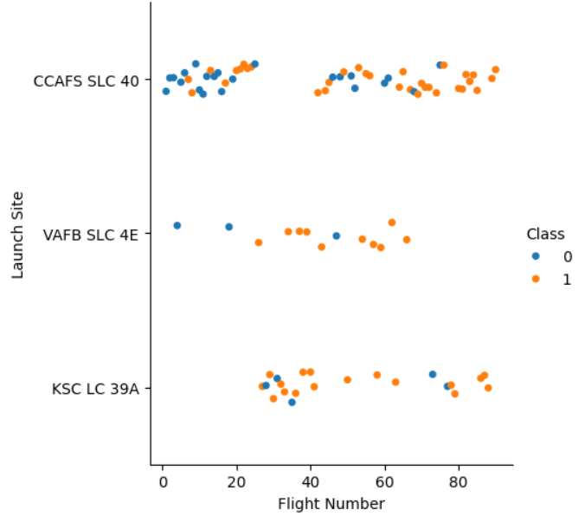
Flight Number vs. Launch Site

Slide 23
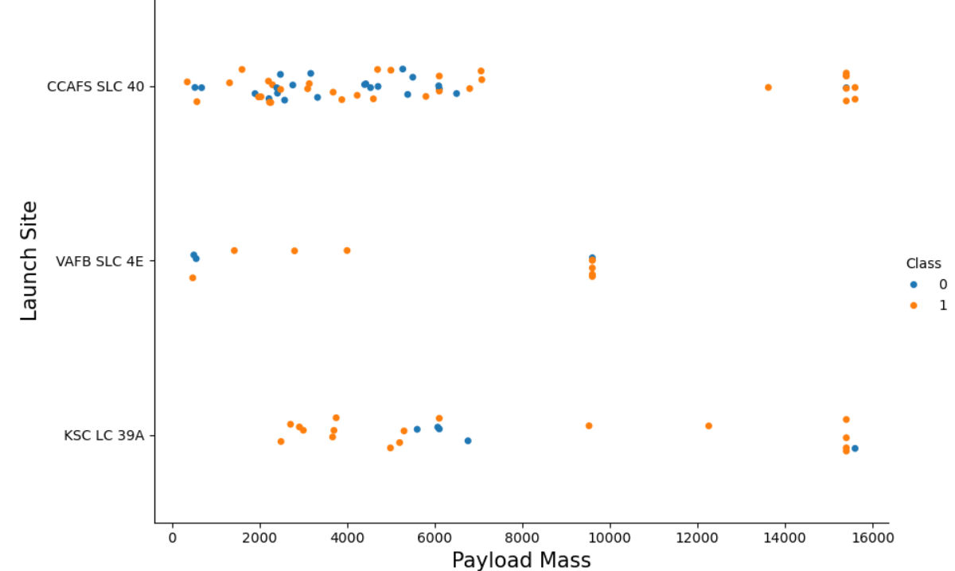
Payload vs. Launch Site

Slide 24
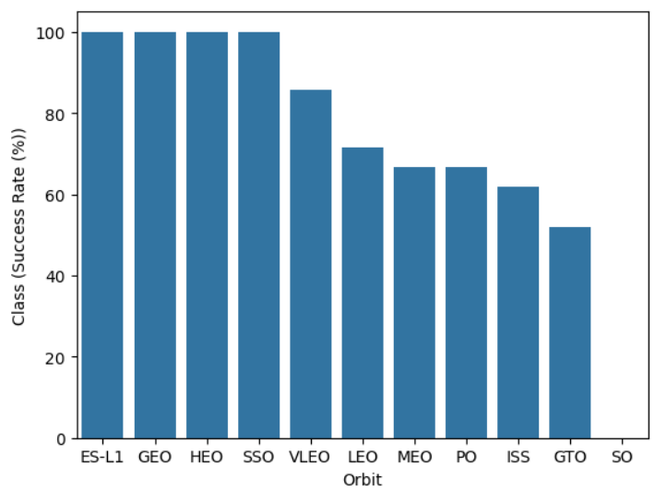
Success Rate vs. Orbit Type

Slide 25
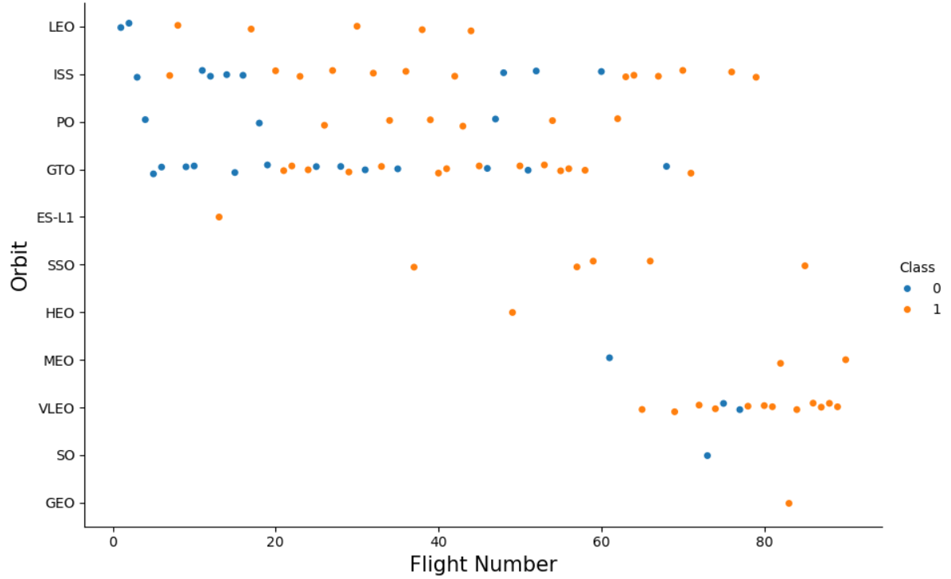
Flight Number vs. Orbit Type

Slide 26
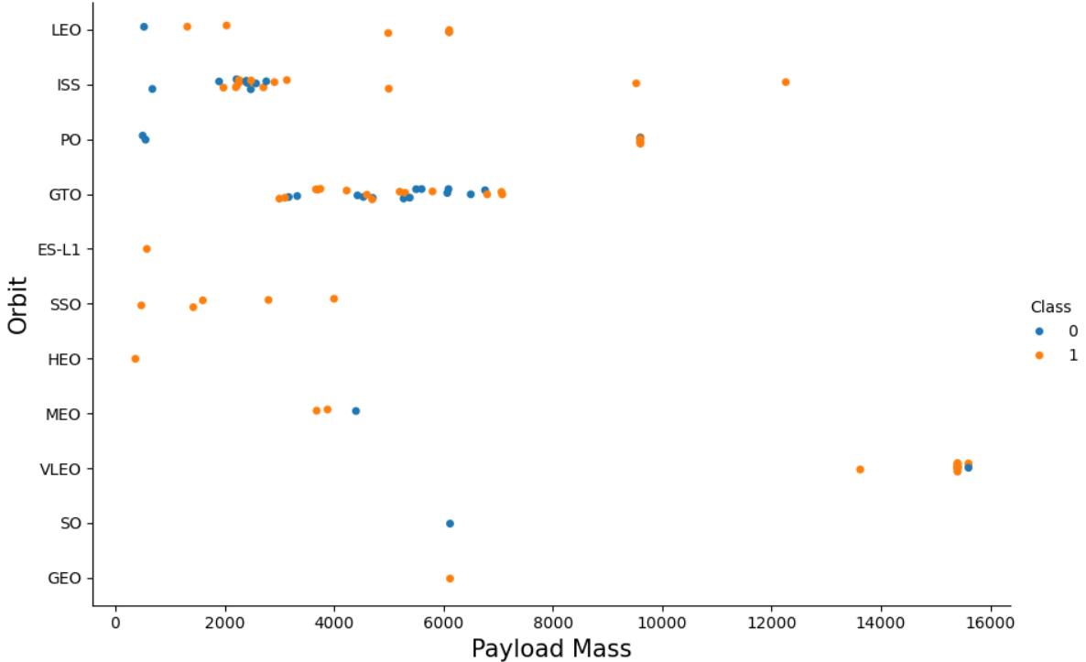
Payload vs. Orbit Type

Slide 27
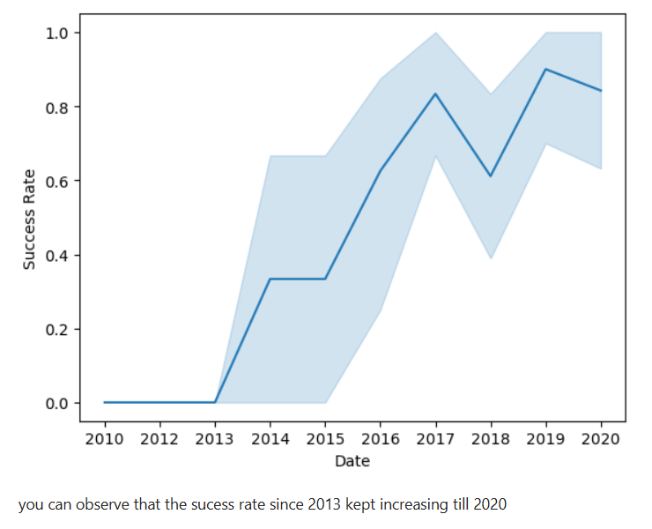
Launch Success Yearly Trend

Slide 28
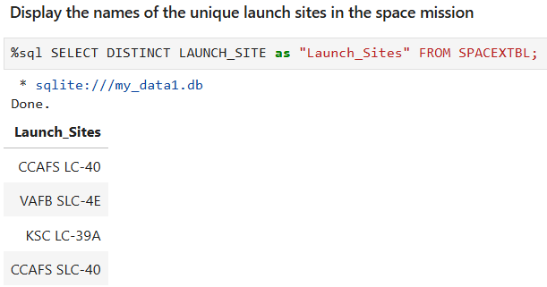
All Launch Site Names

Slide 29
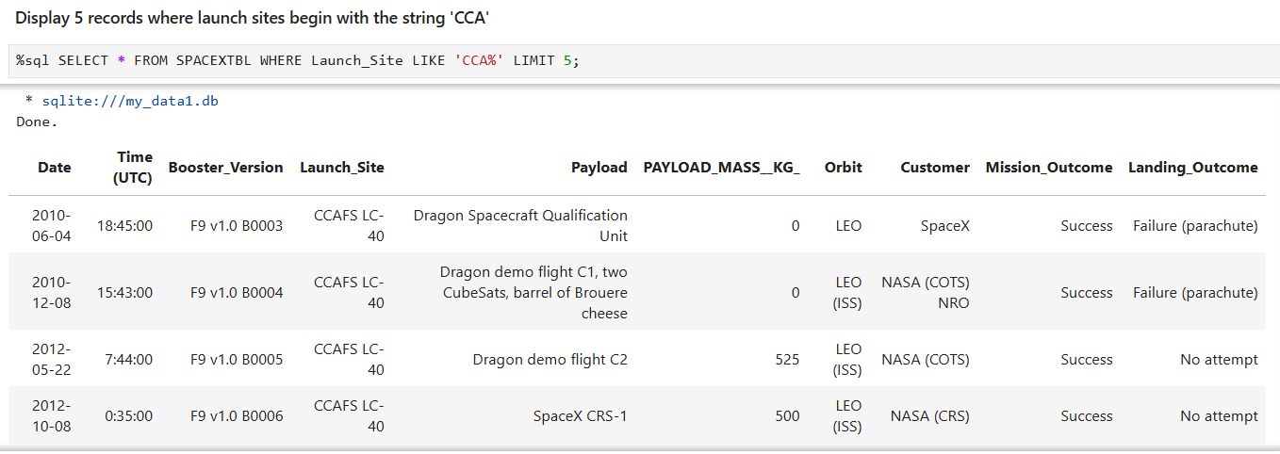
Launch Site Names Begin with 'CCA'
Find 5 records where launch sites begin with `CCA`

Slide 30
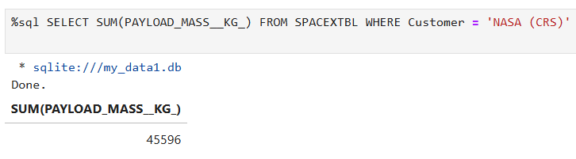
Total Payload Mass
Calculate the total payload carried by boosters from NASA

Slide 31
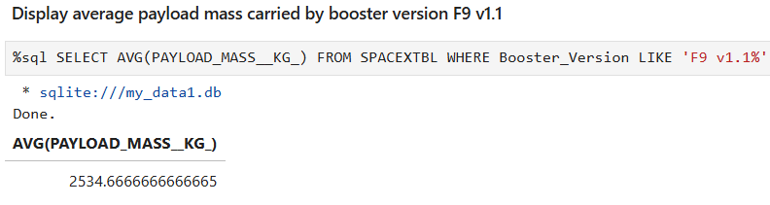
Average Payload Mass by F9 v1.1
Calculate the average payload mass carried by booster version F9 v1.1

Slide 32

First Successful Ground Landing Date
Find the dates of the first successful landing outcome on ground pad

Slide 33

Successful Drone Ship Landing with Payload between 4000 and 6000
List the names of boosters which have successfully landed on drone ship and had payload mass greater than 4000 but less than 6000

Slide 34

Total Number of Successful and Failure Mission Outcomes
Calculate the total number of successful and failure mission outcomes

Slide 35

Boosters Carried Maximum Payload
List the names of the booster which have carried the maximum payload mass

Slide 36

2015 Launch Records
List the failed landing_outcomes in drone ship, their booster versions, and launch site names for in year 2015

Slide 37

Rank Landing Outcomes Between 2010-06-04 and 2017-03-20
Rank the count of landing outcomes (such as Failure (drone ship) or Success (ground pad)) between the date 2010-06-04 and 2017-03-20, in descending order

Slide 38

Section 3

Slide 39

Launch sites on a map
We can see all the location markers of the launch points on a global map, we can see all the launch points very close to the coast.

Slide 40


Success/Failed launches for each site on the map
Show the color-labeled launch outcomes on the map.

Slide 41

Calculate the distances between a launch site to its proximities
Selected launch site to its proximities such as railway, highway, coastline, with distance calculated and displayed

Slide 42

Section 4

Slide 43

Launch success count for all launches sites
Show the screenshot of launch success count for all sites, in a piechart.

Slide 44

Launch site with highest launch success ratio
Show the screenshot of the piechart for the launch site with highest launch success ratio.

Slide 45

Payload vs. Launch Outcome scatter plot for all sites
Show screenshots of Payload vs. Launch Outcome scatter plot for all sites, with different payload selected in the range slider.

Slide 46

Section 5

Slide 47

Classification Accuracy
Model accuracy for all built classification models, in a bar chart
The model who has the highest classification accuracy is Decision Tree

Slide 48

Confusion Matrix
Confusion matrix of the best performing model. Accuracy of knn_cv on the test data using the method score.

Slide 49
Conclusions
Machine learning techniques were applied to predict the landing success of the first leg of the rocket, using models such as logistic regression, decision tree and SVM.
Different models were compared using metrics such as precision and accuracy, identifying which ones offer better predictions based on variables such as launch site, orbit type and payload.
The project helps to make informed data science decisions.
This experience simulates a real use case in the aerospace industry, showing how data science can support critical decisions in space missions.

Slide 50


